Slide 1
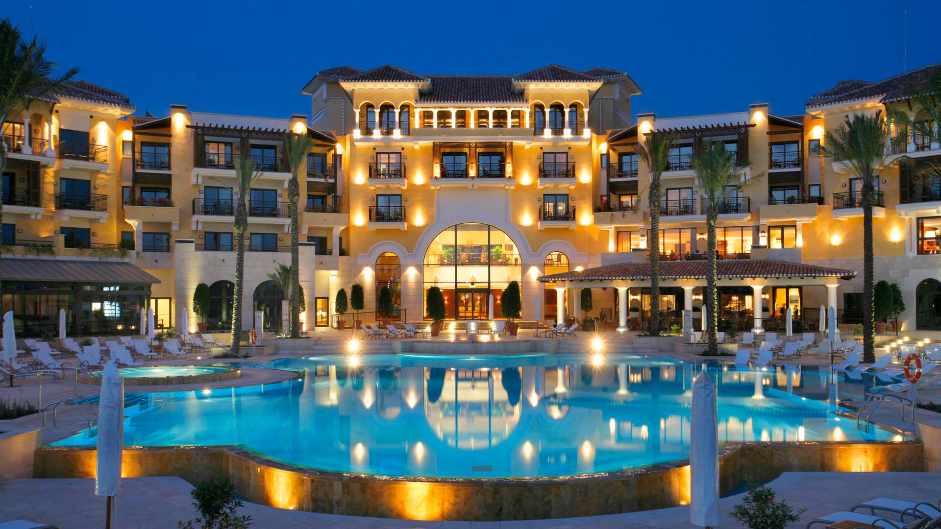
EDA on Hotel Booking Analysis
Project Type -EDA
Presented by –Jay Raval
Guide By – Abhishek Wavhal

Slide 2
SUMMARY OF MY PROJECT
Abhishek sir assigned us a project to analyze the hotel group's business operations.
This Dataset had two hotels City Hotel and Resort Hotel.
The dataset covers three years (2015-2017) and includes revenue, booking details, length of stay, cancellations, total guests, wait periods for bookings, repeat guests, food preferences, and booking origins by country. Additionally, it accounts for bookings made through agents and other channels on behalf of the resorts and city hotels.
The data is split between city and resort hotels, enabling a fair comparison between them.
Prior to visualizing the data, we'll perform data cleaning to address null values and eliminate duplicates, followed by data wrangling.
We'll analyze both city and resort hotels individually and compare their performance. Charts will be used to enhance our analysis.

Slide 3
PROBLEM STATEMENT
The dataset includes booking details for a city hotel and a resort hotel, covering booking timing, guest demographics (adults, children, babies), available parking spaces, booking agent, and more.
The project aims to explore and analyze the data to uncover key factors influencing bookings.

Slide 4
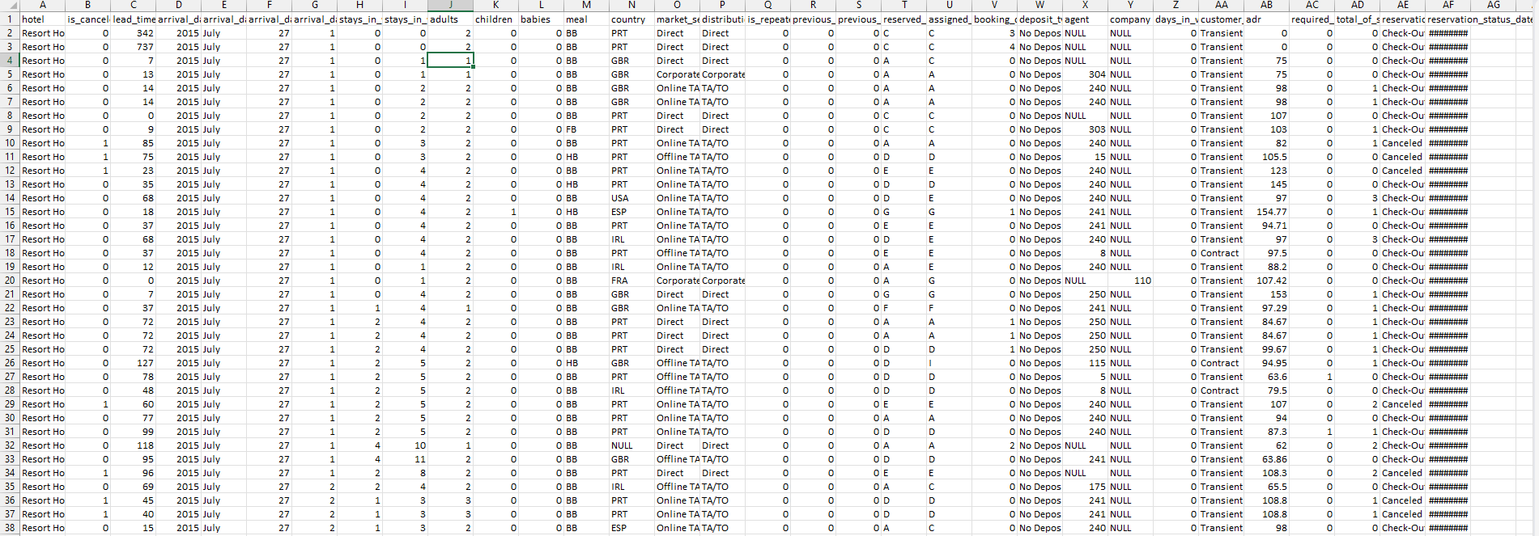
Dataset First View

Slide 5
Columns name we have 119390 index sand 32 columns
Hotel,is_canceled,lead_time,DATE,arrival_date_week_number,stays_in_weekend_nights,stays_in_week_nights,TOTAL_STAY,adults,children,babies,TOTAL GUEST,meal,country,market_segment,distribution_channel,is_repeated_guest,previous_cancellations,previous_bookings_not_canceled,reserved_room_type,assigned_room_type,booking_changes,deposit_type,agent,days_in_waiting_list,customer_type,adr,required_car_parking_spaces,total_of_special_requests,reservation_status,reservation_status_date,Customer ID,Week Days

Slide 6
What did you know about your dataset?
The given dataset is of Hotel Booking and we have to analyze and explore this dataset to discover important factors which affects the Hotel Booking. This dataset has 119390 rows and 32 columns.
The value error is in 4 rows
The duplicate value count is 31993 rows.
There are 4 columns in dataset which is having missing values and those columns are company, agent, country and children.
There are separate columns called adults, children and babies that show the total number of people who are coming to visit, so instead of different columns will add in one called Columns “TOTAL GUEST”
We'll consolidate the “stays_in_weekend_nights" and "stays_in_week_nights" columns into a single column named "TOTAL_STAY" to represent the total number of nights stayed by visitors.
We'll combine the "arrival_date_year," "arrival_date_month," and "arrival_date_day_of_month" columns into a single column named "Date" to represent the arrival date.

Slide 7
Variables Description
hotel - Type of hotel(Resort or City).
is_canceld - If there was booking cancel(0) or not(1).
lead time - The number of days between time books their room to arrive hotel.
arrival_date_year - Year of arrival date.
arrival_date_month - Month of arrival date.
arrival_date_week_number - Week no. of year for arrival date.
stays_in_weekend_nights - No. of weekend nights(Saturday or Sunday) spend by guest at hotel.
stays_in_week_nights -No. of weeknight( Mon to Fri) spend by guest at hotel.
adults - No. of adults among guest.
children - No. of children among guest.

Slide 8
Variables Description
babies - No. of babies among guest.
meal - Type of meal booked by guest.
country - Country of guest.
market_segment - grouping into categories based on their booking patterns and travel habits.
distribution_channel - Name of booking distribution channel.
is_repeated_guest - If the booking was from repeated by guest(1) or not(0).
previous_cancelletions - No. of previous booking that were cancelled by the customer prior to the customer booking.
previous_booking_not_canceled - No. of previous booking that were not cancelled by the customer prior to the customer booking.
reserved_room_type - Code of room type reserved.
assigned_room_type - code of room type reserved.
booking_changes - No. of changes made to the booking.

Slide 9
Variables Description
deposit_type - Type of the deposit made by the guest.
agent - Id of the agent who made the booking.
company - Id of the company that made the booking.
days_in_waiting_list - No. of days the booking on the waiting list.
customer_type - Type of customer, assuming one of four categories.
adr - (Average Daily Rate) dividing the sum of lodging transaction by the total number of staying night.
required_car_parking_spaces - No. of car parking spaces required by the customer.
total_of_special_request - No. of special request made by the customer.
reservation_request - Reservation status
reservation_request_date - Date of last reservation status updated.

Slide 10
Data Wrangling We already did some data cleaning before lets go for data Wrangling
Total staying days in hotels
Sum of adults+ child+ babies
We remove error from child column
We create date with using column [arrival_date_year, arrival_date_month, arrival_date_day _of_month ]
We remove the all duplicates value from entire database

Slide 11
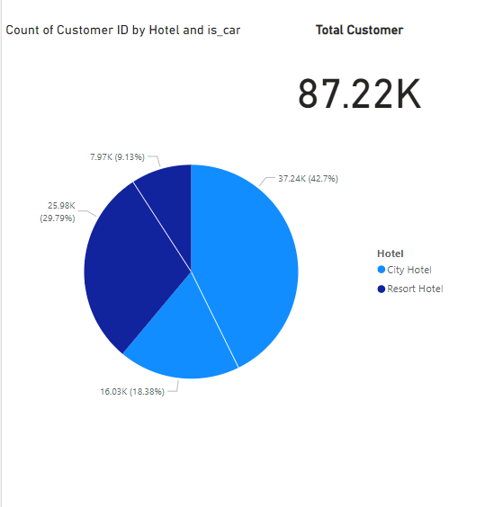
HOTEL BOOKINGS & CANCELLED FIND THE TOTAL NUMBER OF BOOKINGS. CALCULATE THE CANCELLED BOOKINGS OF HOTELS.
We have 4 Types of Data that’s Why We use pie chart in this Question . The Booking Ratio of Hotels is as follows:-
A. Resort Hotel : 25982
B. City Hotel : 37239
The Canceled Ration Of Hotel is As
Follows:-
A. Resort Hotel : 7966
B. City Hotel : 16031

Slide 12
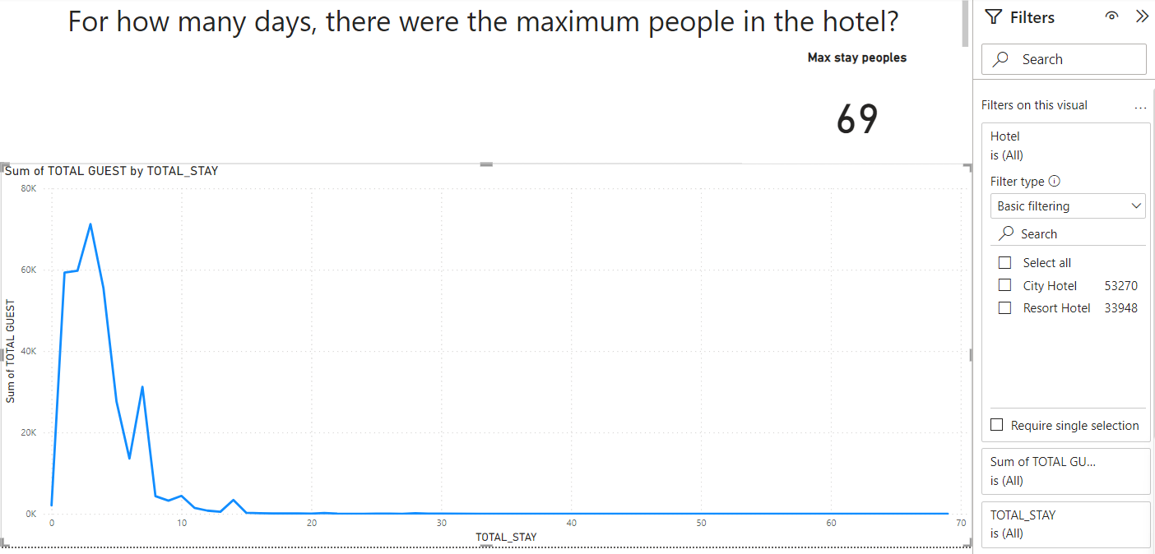
Long-Term Stay Analysis: Quantifying Extended Occupancy Trends
Here we are using line graph as there are more than 10 categories and it is easier to analysis the data.
We have found that for 3 days there were maximum people in the hotel that is 71,214.

Slide 13
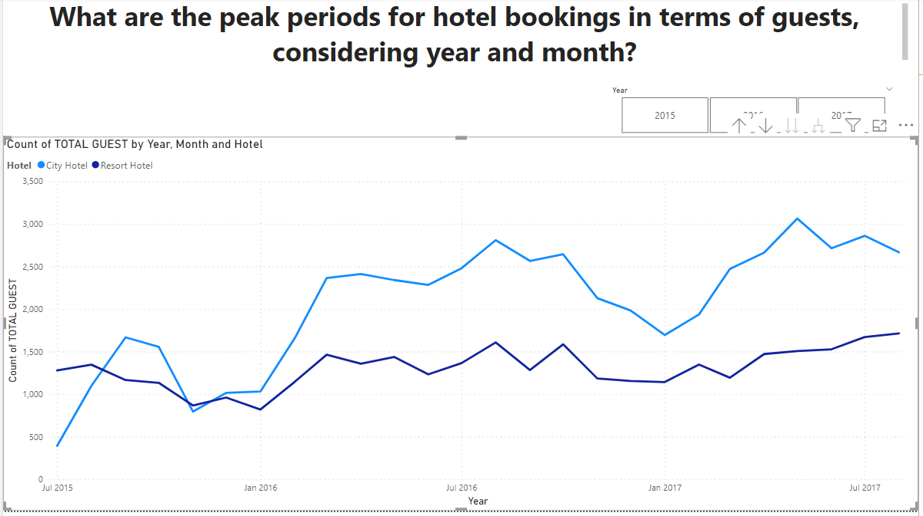
Peak Periods Analysis: Examining Hotel Booking Trends by Year, Month, Quarter, and Day
We have used line chart.
We have analyzed in May’2017 there was max bookings for City Hotel.
In Aug’2017, there were max bookings for Resort Hotel.

Slide 14
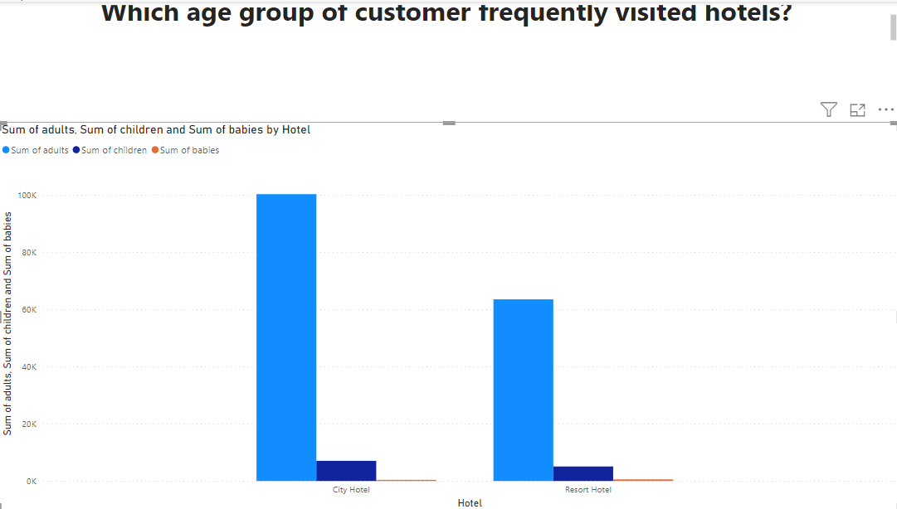
Customer Demographics Analysis: Identifying the Most Frequent Age Group Visiting Hotels
We have used bar graph as it has more than 3 categories and it suitable to picturize the data.
We have found that Adults are the max age group which is visiting the hotels.

Slide 15
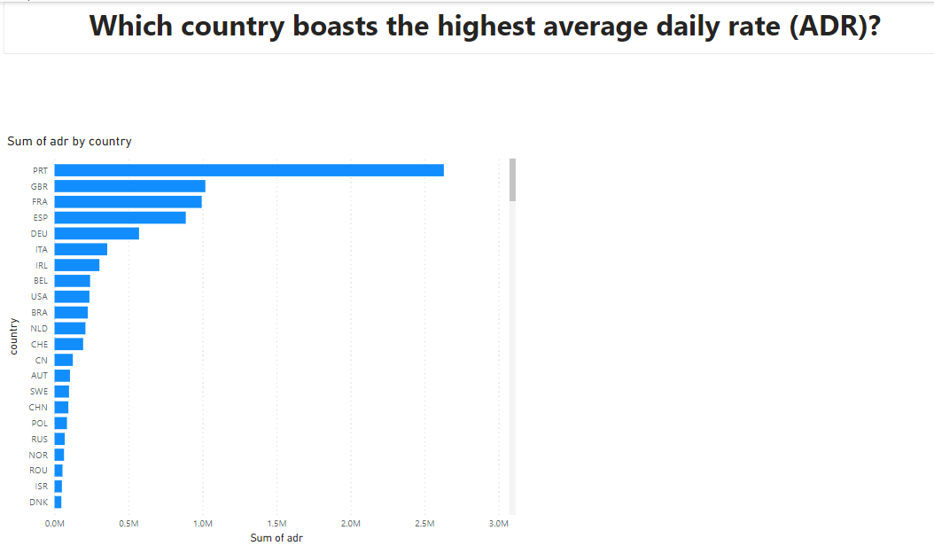
Country with the Highest Average Daily Rate (ADR): A Comparative Analysis
We have used clustered bar chart.
Here in the Bar graph, PRT has the Highest Average Daily Rate at 26M.
Lowest is the DNK at 45k.

Slide 16
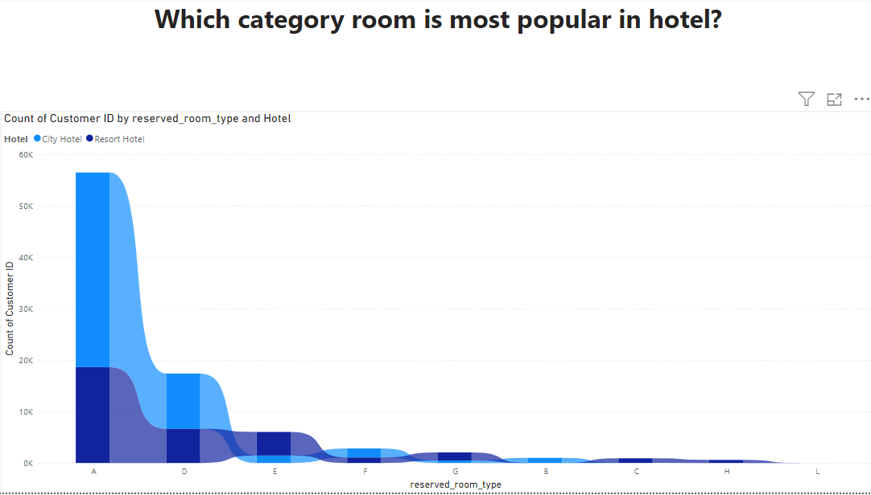
Preferred Room Types: Analyzing Customer Preferences in Hotel Accommodations
We have used Ribbon chart and it makes the data visually appealing.
We have found that room type A is most liked room for the customers in City hotel and Resort hotel both.

Slide 17
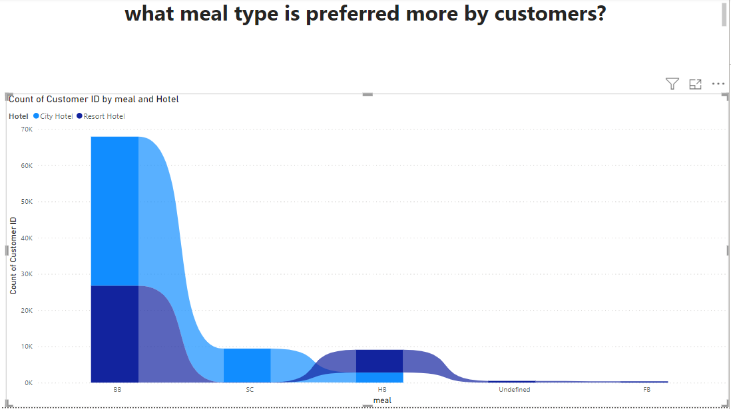
Customer Preference Analysis: Identifying the Most Preferred Meal Type
We have used Ribbon bar graph to see which kind of meal is liked by the guests.
We have found that BB is the most popular in both the hotels.

Slide 18
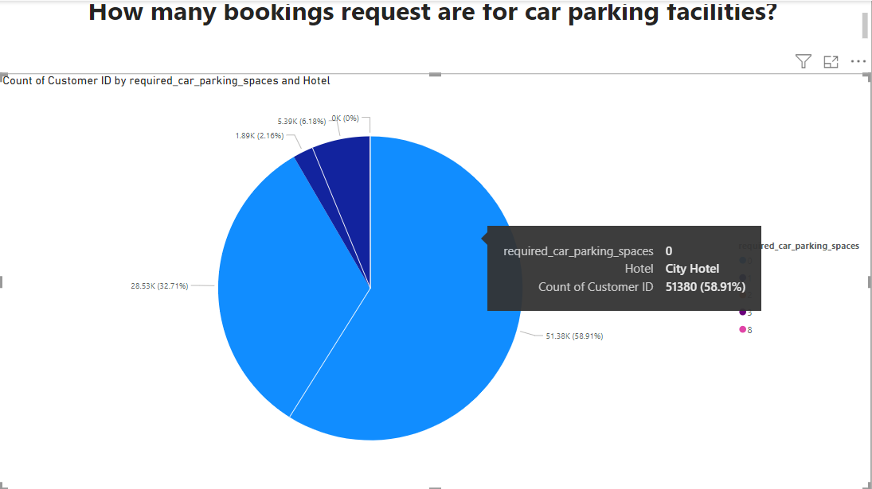
Analysis of Booking Requests for Car Parking Facilities
We have used pie chart to see that how many guests are using the parking facilities.
2.16% people preferred to use parking in City hotel and 6.18% people preferred parking in Resort hotel.

Slide 19
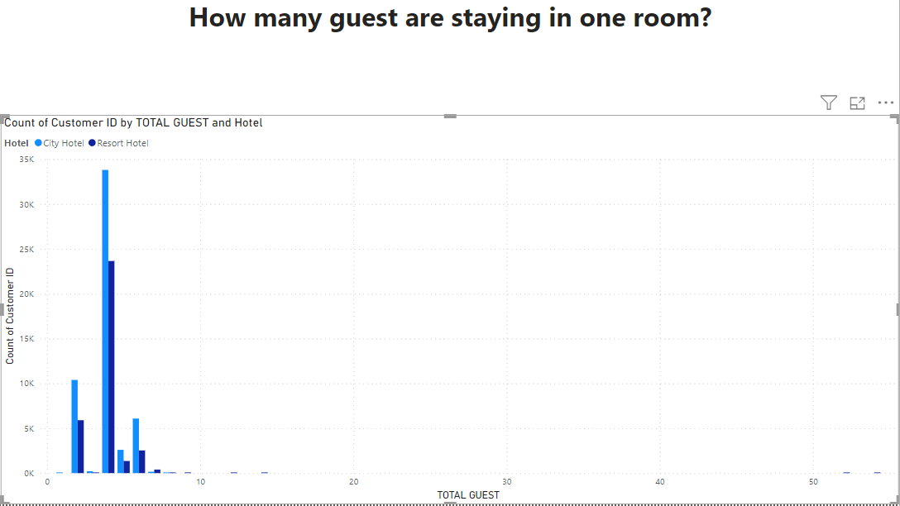
How many guest are staying in one room?
We have used the clustered column graph to see that how many persons are staying in 1 room.
We can observe that there are 33K people who stays in group of 4 in a single room in City hotel. 23K people stays in group of 4 in a single room in Resort hotel.

Slide 20
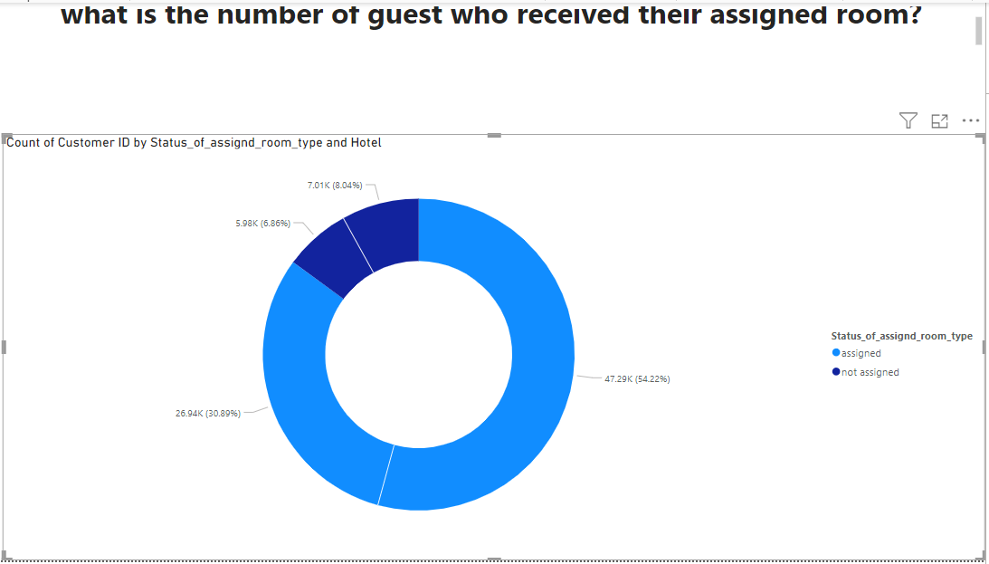
Analysis of Guests Receiving Assigned Rooms: Room Allocation Success Rate
We have used Donut graph to see the ratio as is the selected room is assigned to the customers or not.
We can see that in City hotel 47.29k people are getting their selected room and 5,98k are not getting their selected room.
On the other hand in Resort hotel, 26.94k people are getting their selected room and 7.01k are not getting their selected room.

Slide 21
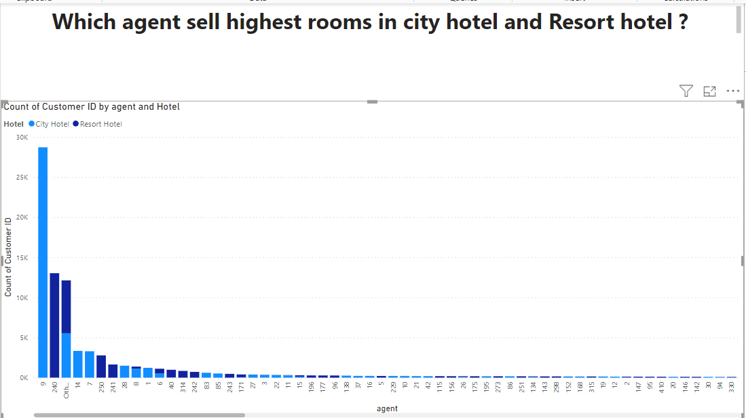
Agent Performance Analysis: Number of Rooms Sold by Each Agent
We have used the line and stacked graph to see which agent is able to sell the highest rooms in the hotels.
We have found that Aged 9 is able to sell the highest number of rooms in City hotel and on the other hand agent 240 is able to sell the highest rooms in Resort hotel.

Slide 22
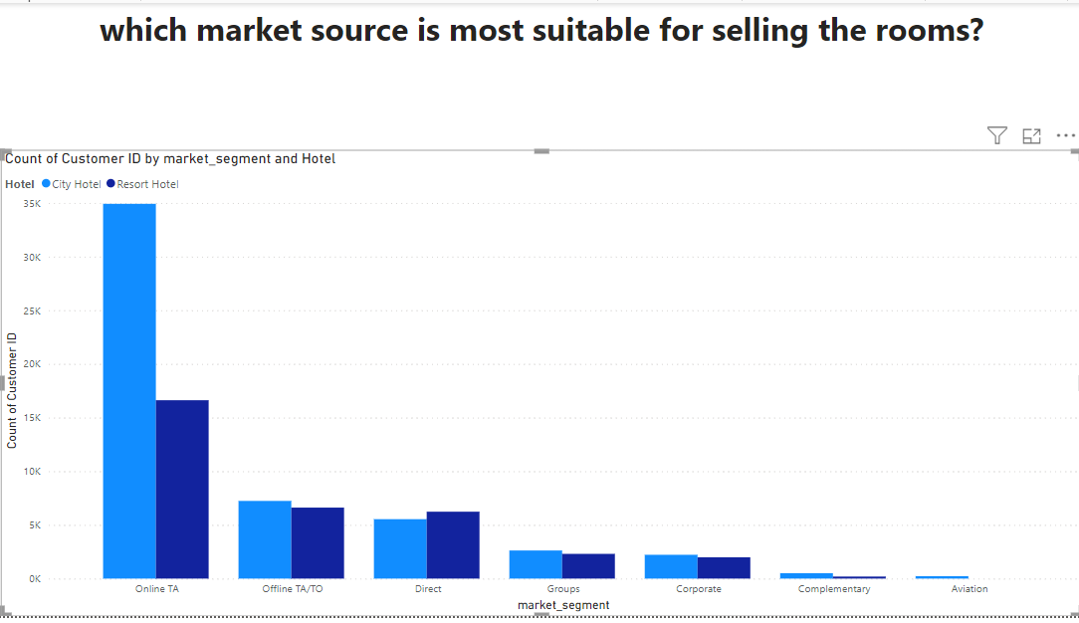
Market Source Analysis: Identifying the Most Effective Channel for Room Sales
We have used the bar graph to analyze which market is most suitable to sell the rooms. We have got the online TA channel as the most superior to sell the rooms.

Slide 23
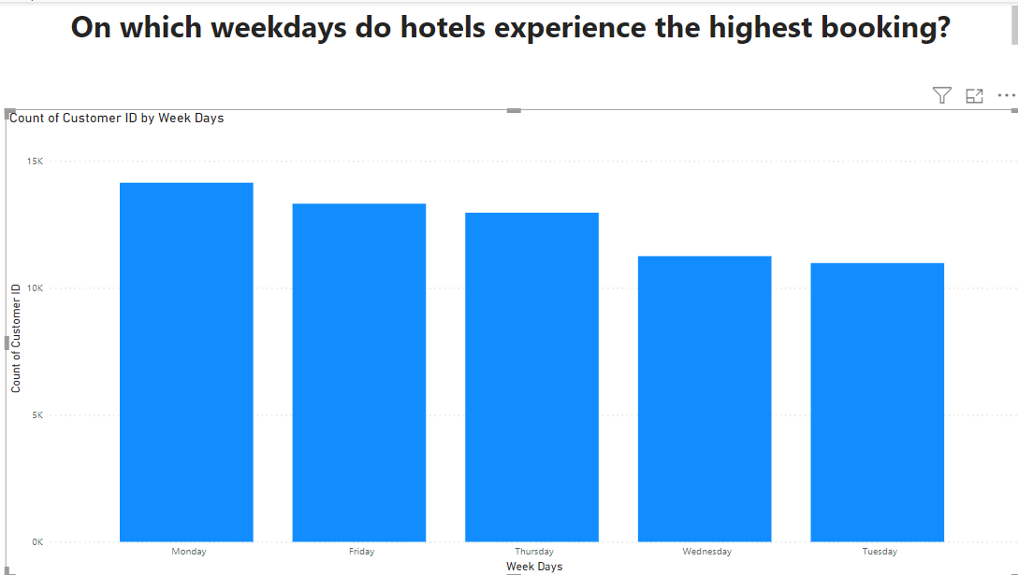
Weekday Booking Analysis: Identifying Peak Booking Days for Hotels
I have used column chart as better understanding.
We have identified that on Monday there is maximum bookings happening in the both hotels.
We have used filter to see the hotel wise data.

Slide 24
Cancellation Analysis:
Investigate the correlation between lead time and cancellations.
There's typically a noticeable correlation between lead time (the period between booking and stay) and cancellations. Longer lead times often lead to higher cancellation rates due to potential changes in travel plans or unforeseen circumstances.
Determine the most common reasons for cancellations.
Change in Plans, Financial Constraints, Health Concerns, Booking Mistakes, Unsatisfactory Reviews or Ratings, Competing Offers , Weather or Natural Disasters, Family or Personal Issues, Travel Restrictions(Changes in travel restrictions, visa issues)

Slide 25
Cancellation Analysis:
Investigate the impact of previous cancellations on current bookings
Investigating the impact of previous cancellations on current bookings is crucial in the hospitality industry. Past cancellations can influence potential guests' decisions, affecting the conversion rate. Hotel management should analyze factors contributing to past cancellations and implement measures like better communication and flexible policies to rebuild trust. Proactive efforts to address previous cancellations can enhance the hotel's reputation, encourage future bookings, and foster customer loyalty in a competitive market.

Slide 26
Suggestion and Solution to Business Objective
Recognizing the surge in hotel bookings from April to August, it's crucial for hotel management to strategically plan for this peak period. Increasing staff levels and ensuring adequate supplies during these months are essential to meet heightened demand and maintain service standards. Aligning staffing and resources with the increased demand allows hotels to optimize operations, enhance customer satisfaction, and maximize revenue during the peak travel season.
To attract customers and boost the average daily rate, a resort hotel should prioritize attention to all essential amenities. By offering a wide range of services and facilities, the hotel can enhance its appeal to guests seeking a complete and enjoyable experience.

Slide 27
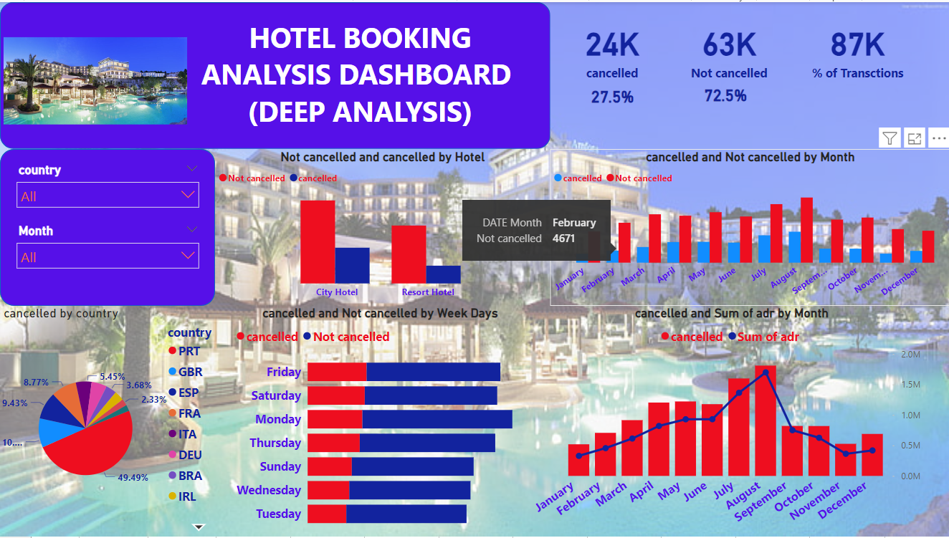

Slide 28
Result or Conclusion
In this project, we observed a preference for city hotels, with peak bookings and revenue in 2016. Given that most customers don't require car parking, minimizing investment in parking facilities is advisable. July and August consistently show peak booking periods, likely due to vacations and increased travel. Bookings through agents are predominant, with guests mainly from Portugal, the United Kingdom, France, and Spain. A and D room categories are popular, with guests often returning to their previous choice of hotel. The preference for BB-type food is notable. As bookings and guest arrivals increase, the Average Daily Rate (ADR) also rises, indicating a positive correlation between ADR and the number of guests. This suggests potential financial growth as occupancy rates increase.

Slide 29
* Thankyou *

